Slide 1
Sentiment Analysis of Twitter Data By Sahar A. El_Rahman, Feddah Alhumaidi AlOtaibi, Wejdan Abdullah AlShehri
Harshit Jain 1911017 A1
RDBMS IA-1

Slide 2


Introduction
The online social media such as Twitter, Facebook, and Instagram allow users to communicate with the whole world. Write their own opinions about products or share their moments, even influence politics and companies. Take Twitter for example, almost every huge company have an account on Twitter to know about their customers feedback about their services or products.
In this paper, they have used sentiment analysis to classify specific English tweets about two restaurants, KFC and McDonald’s. Their research was to determine which one was better than the other.

Slide 3
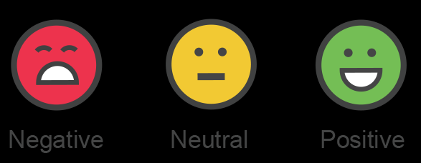
Sentiment Analysis
Sentiment Analysis is the process of determining whether a piece of writing is positive, negative or neutral. A sentiment analysis system for text analysis combines natural language processing (NLP) and machine learning techniques to assign weighted sentiment scores to the given piece of writing. Sentiment analysis helps data analysts within large enterprises gauge public opinion, conduct nuanced market research, monitor brand and product reputation, and understand customer experiences

Slide 4
Methodology
01
Extracting the Tweets

Slide 5

Extracting The Tweets
R language was used to extract the tweets. R is a programming language used for statistical computing and machine learning algorithms. In order to extract tweets from Twitter, Twitter API were used. Necessary packages and libraries were installed, some of the packages are (TwitteR, rtweet, R0Auth). By using twitteR package you can extract tweets up to 4000 only. On the other hand, by using rtweet package, which is way better than twitteR as it allows you to extract up to 20,000 tweets.
Number of tweets extracted

Slide 6
Methodology
01
02
Extracting the Tweets
Exploring The Data

Slide 7

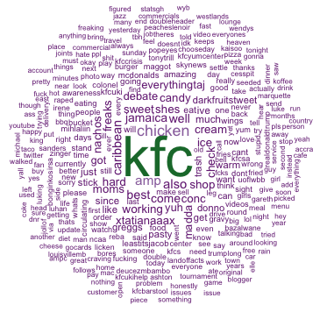
Exploring The Data
To get more sense about the data, word clouds were created using “wordcloud” package in R, generating word cloud from text gives more sense about the most frequently words used in tweets about a specific topic.

Slide 8
Methodology
01
02
03
Extracting the Tweets
Preprocessing
Exploring The Data

Slide 9
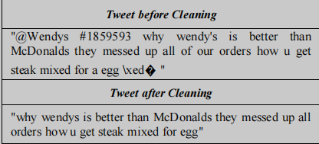
Preprocessing
As the text is highly dimensioned unstructured data, it has to be cleaned and prepared first before analyzing it. Preprocessing the data involves many tasks, depending on type of analysis. In this case since we are interested in text only. The text was extracted from tweets and converted into data frame, URLs were removed,stop words like (the, a, to...) were removed, usernames and accounts , numbers and unnecessary spaces, punctuations were removed and converted encoding (Emojis) from latin1 to ASCII. After cleaning the text and removing unnecessary symbols, the analysis was performed.

Slide 10
Methodology
01
02
03
04
Extracting the Tweets
Preprocessing
Exploring The Data
Model Building

Slide 11
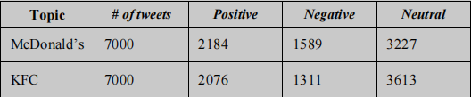
Model Building
As pre-classified data was not available, a lexicon-based model was used to classify tweets. Two text files containing a list of positive and negative words, along with more words related to the domain were used. Each word within each tweet is compared to positive and negative documents in order to find matching words, and classify tweets whether it has more positive or negative words.
LEXICON BASED CLASSIFICATION

Slide 12
Model Building
Once the data is classified multiple supervised learning algorithms were applied for the purpose of training: Naive Bayes, support vector machine (SVM), maximum entropy, decision tree, random forest and bagging.
Metrics which were used to validate and test the accuracy of each model are Recall, Precision, Fscore, Cross validation.

Slide 13
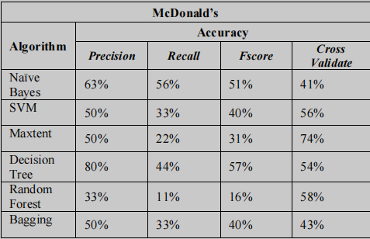
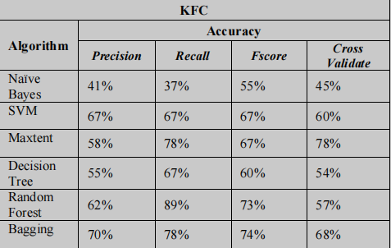
Accuracy Result

Slide 14

Conclusion
The presented methodology combined the use of unsupervised machine learning algorithm where previously labeled data were not exist at first using lexicon-based
algorithm. After that data were fed into several supervised model. For testing various metrics used, and it is shown that based on cross validation, maximum entropy has the highest accuracy. As a result, McDonalds is more popular than KFC in terms of both negative and positive reviews. Same methodology can be used in various fields, detecting rumors on Twitter regarding the spread of diseases.

Slide 15
Implementation Details
Sentiment analysis on movie reviews / fake news.
Use Dataset from Kaggle .
Use Vader (Valence Aware Dictionary and Sentiment Reasoner) to get the intensity of the emotion.

Slide 16
THANK YOU!!

